Slide 1
Category review: Chips
June 2020
Retail Analytics
Brand note: If client logo is not required, use alternate title page layout right click slide thumbnail > Layout > Title

Slide 2
Notes:
To view Privacy video explaining how important data privacy is to Quantium, please click here: https://www.youtube.com/watch?v=Zq1QDAkoRzU
or here Q:\Company Reference\Brand & Design\Brand videos\Q Privacy.mp4
At Quantium, we believe that data is the behavioural footprint of humanity and that it has to be treated with the utmost care and responsibility.
Histories, attitudes, indeed lives are stored within it in ways that aren’t always apparent – and that’s what makes its potential so powerful.
To work with it responsibly, sensitively, we set ourselves the highest data privacy protection and governance standards.
We have spent 17 years perfecting privacy-by-design and secure-by-design principles. Central to this is not holding any personally identifiable information about people –
we neither receive it, and put the necessary protections in place to be unable to decipher it.
Every aspect of handling data is safeguarded: from its de-identification, to its encryption – data security is paramount and of the highest grade.
We pride ourselves on gaining the trust of iconic organisations around the world through years of securely working with their data,
and in turn the trust that builds with their stakeholders.

Slide 3
Executive summary
Most Lucrative Customer Segments: Budget Older Families, Mainstream Young Singles and Couples, Mainstream Retirees.
Most Popular Brands: Kettle, Smiths, Doritos, Pringles.
Most Popular and Lucrative Stores: Store 226, Store 88, Store 165
Most Popular Pack Sizes: 175g, 150g, 134g
01
Task 1
02
Task 2
Trial Store Layout has a positive effect on total sales and total customers.

Slide 4
01
Category

Slide 5
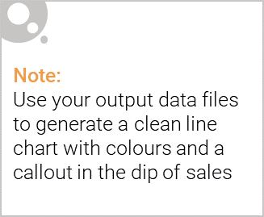
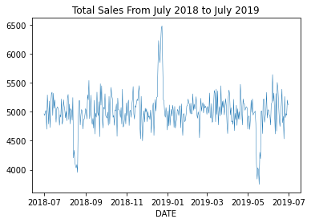
Category Key Layouts
Total Sales of chip products peaks over Christmas and dips in August and May.
Kettle is the most popular brand and 175g is the most popular pack size across the board.
Budget Old Families is the highest spending customer segment in terms of total sales, but is only 6th largest.

Slide 6

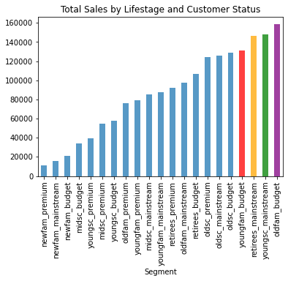
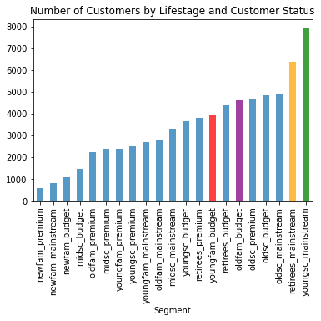
Total Sales vs Proportion of Customers
The total sales by customer segment does not seem to follow the order of size of customer segment in any meaningful way.

Slide 7
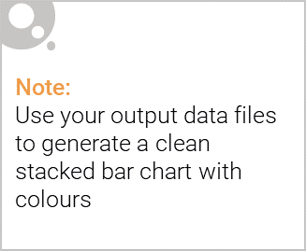
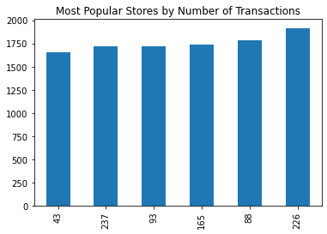
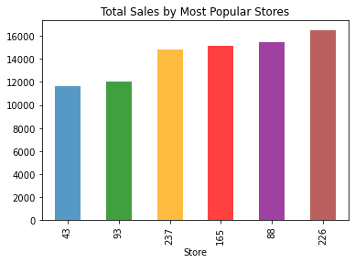
Editable (delete this)
Stores by Popularity and Total Sales
The order of total sales follows the order of store popularity almost exactly, with only stores 93 and 237 reversed in order.

Slide 8
02
Trial store performance

Slide 9
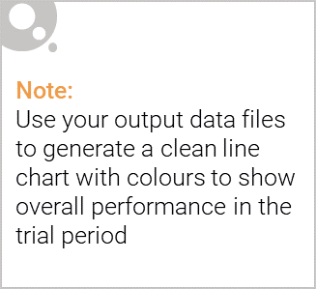
Trial Stores and Control Stores
To measure performance of trial stores (circles) we compare them to the performance of control stores (squares).
Thee are the stores with the maximum correlation over total sales and total customers in the pretrial period.
Each colour is a different trial-control store pair showing the correlation in the pre-trial period and the divergence in performance during the trial period.
The graphs are followed on the next slide.

Slide 10
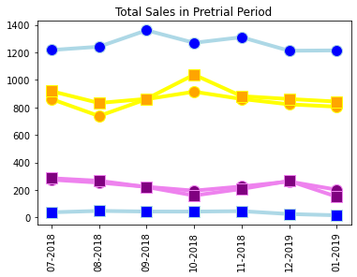
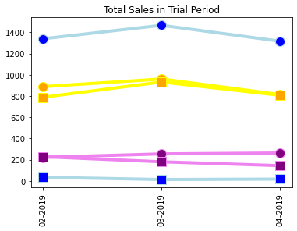
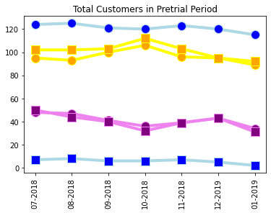
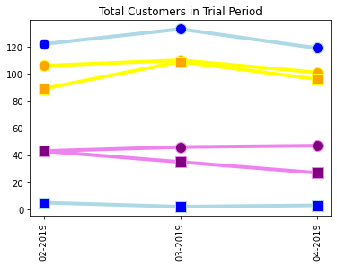

Slide 11
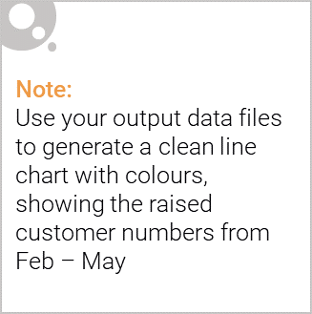
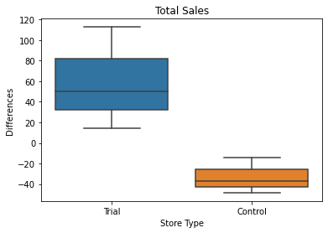
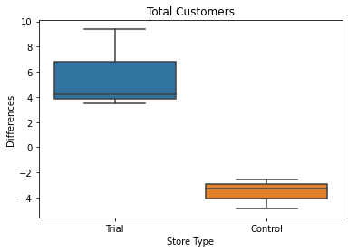
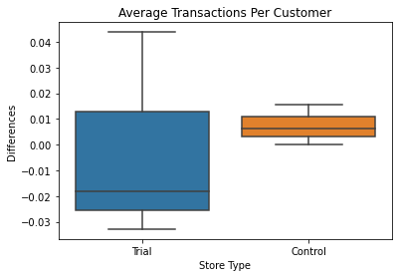
Performance of Trial Stores
On total sales and total customers, we see that the trial stores performed better than the control stores over the trial period.
On average transactions per customer, there was no overall increase in performance.

